Slide 1
Applecross Annual Meeting 2024
CAS HOA Management
Applecross HOA Board of Directors
October 29, 2024

Slide 2

Agenda
Call to Order
Introduction of current Board of Directors & Community Manager
President’s Report
Financial Report
September Financials
2025 Approved Budget
Nomination for Board of Directors & Elections
Questions
Adjournment

Slide 3

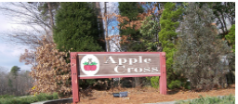
Our Team
Mat Cordialini, Community Manager
HOA Board of Directors:
About Applecross:
919-367-7711, ext. 1506
Email: Matt@casnc.com
Leigh LeClair, President – Term over
Joanna Willard, Vice President
Melissa Stewart, Secretary
David Baratta, Treasurer
The Applecross townhome community was built in the 1980’s and is comprised of 149 townhomes within 28 buildings.
Website:
https://www.casnc.com/communities/applecross/

Slide 4
President’s Report
28-building Carpentry and Painting Project
Contract awarded to Color Spectrum LLC.
Exterior repairs precede the painters.
Colors were changed after the original colors did not work well with the Cedar Siding.
Painting Project is ongoing, currently working on Inverness Ct.
Colors Selected: Sherwin Williams Blustery Sky (SW9140) and Stamped Concrete (SW7655) along with white trim.
Notes:
The Board recognized the need to update the 1980’s building color palette and performed their due diligence by consulting with Sherwin Williams color consultants as well as professional interior and color consultants MG Interiors (https://mgerrityinteriors.com/).

Slide 5
President’s Report, cont.
Applecross 28-building Carpentry and Painting Project Scope
In Scope | Out of Scope
The Project includes: Power washing Caulking Siding and trim repair and/or replacement Two coats of paint Includes: building siding, building trim, doors (front, back, storage, crawlspace), front porch posts, railings, and balusters, community entrance sign Once painting is completed, power washing of sidewalks | The following is NOT included in the Project: Front porch decking, stairs/steps, and risers Back deck decking, posts, railings, stairs/steps, and risers Owner-added items (e.g., yard fences, screened porches, ramps)
Notes:
The Board recognized the need to update the 1980’s building color palette and performed their due diligence by consulting with Sherwin Williams color consultants as well as professional interior and color consultants MG Interiors (https://mgerrityinteriors.com/). This also included a new color palette for the front doors which allows the residents a way to further individualize their home.

Slide 6
President’s Report, cont.
Roads
Groundskeeping
Building Maintenance
Ongoing: Keeping potholes filled. Resurfacing damaged parking spots as needed.
Future: Resurface or replacement.
Diversified Commercial Services (DCS) effective September 2023.
Drainage, trees, and shrubs.
Mulching the buildings and playground area.
Tree maintenance ongoing project. Dead and dying trees being removed as well as those overhanging roofs to prevent damage.
HOA responsibility: roof, siding, trim, gutters & downspouts, decks & deck fences, front porch.
Owner responsibility: everything behind the siding, structural support, foundation, fireplace, owner-added items (e.g., ramps, screened porches, yard fences).
Owner Safety Tip: Please have a chimney sweep clean your fireplace every year to reduce the risk of fire.

Slide 7
President’s Report, cont.
Deck Repairs
Decks - Replacement
Repairing decks as needed. Rotting boards are replaced as needed and when reported to CAS.
To prevent Deck rot – please do not have outdoor rugs on decks and large number of plants that may hasten the damage to decks.
Decks needing full replacement are being done to Current CARY Building Codes.
Total Deck Replacements will have composite deck boards to keep consistent color with wood balusters stained to match deck boards.

Slide 8
President’s Report, cont.
Trash & Recycling Bins
Know before you go!
Neighborly Etiquette
Within 24 hours ahead of garbage pickup, move the bins to the front for service.
Within 24 hours after garbage pickup, move the bins to the back of the building, out of sight from the street.
Any and all updates to the buildings and grounds must be approved by the ARC committee. This includes doors, windows, gardens, fences, EV Chargers, etc.
To maintain your roof’s warranty, ALL additions or changes to the roofs must be ARC approved and work conducted by RoofWerks (e.g., solar panel, satellite dish, skylight).
When walking your dog, collect the poop and take it home to dispose of it properly.
Being mindful of privacy, please use the public roads, sidewalks, and trails instead of your neighbors’ front & back yards for walking.
Send Questions to
Matt@casnc.com

Slide 9
Applecross Financial Reports
9
Applecross Annual Meeting
October 12, 2023

Slide 10
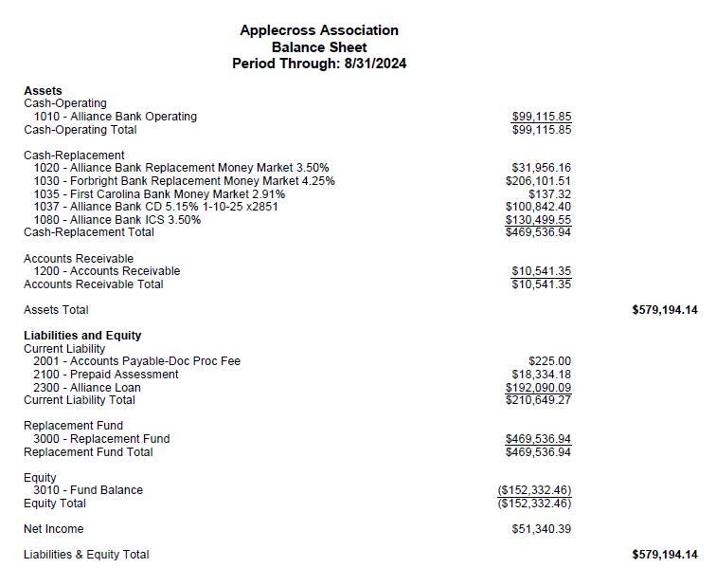
Applecross Financial Report:
Mtt to Update

Slide 11
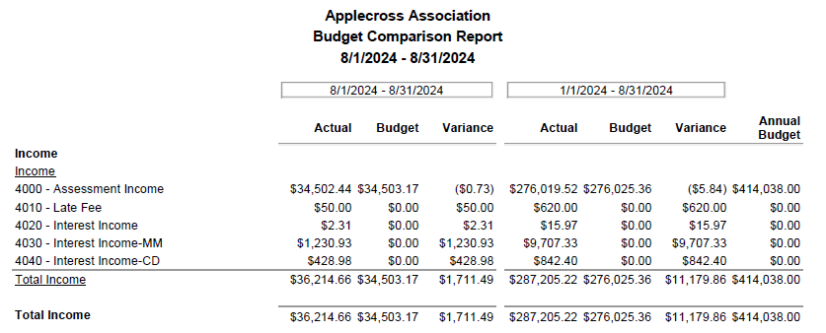
Applecross Financial Report:

Slide 12
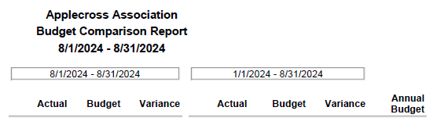
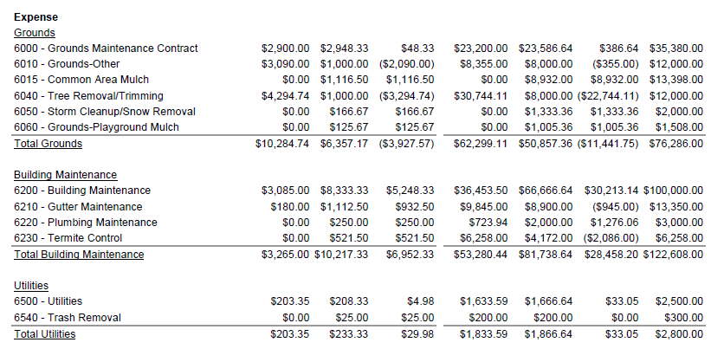
Applecross Financial Report:

Slide 13
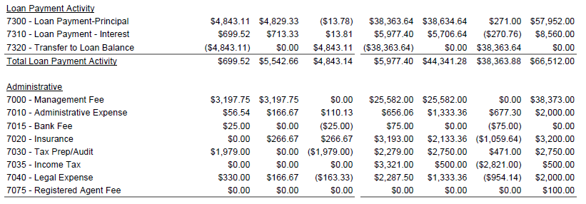
Applecross Financial Report:

Slide 14
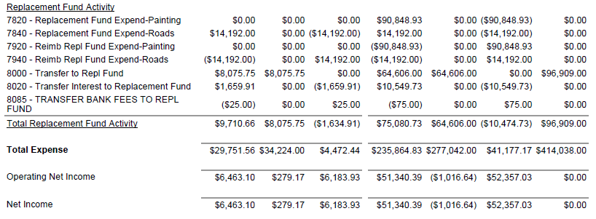
Applecross Financial Report:

Slide 15
Applecross 2025 Budget:

Slide 16
Applecross 2025 Budget:

Slide 17
Applecross 2025 Budget:

Slide 18
Applecross 2025 Budget:

Slide 19
Board Nominations
Nominations for the Board of Directors and Elections requires 10% of community to establish Quorum.
Any nominations received at the CAS office and floor nominations tonight will be included on ballot.
Submitted Nominations: Jason Gaspar – 513 Applecross Dr
Floor Nominations?

Slide 20
Questions?
20
Applecross Annual Meeting
October 12, 2023

Slide 21
Thank you
CAS HOA Management
Applecross HOA Board of Directors

